Slide 1
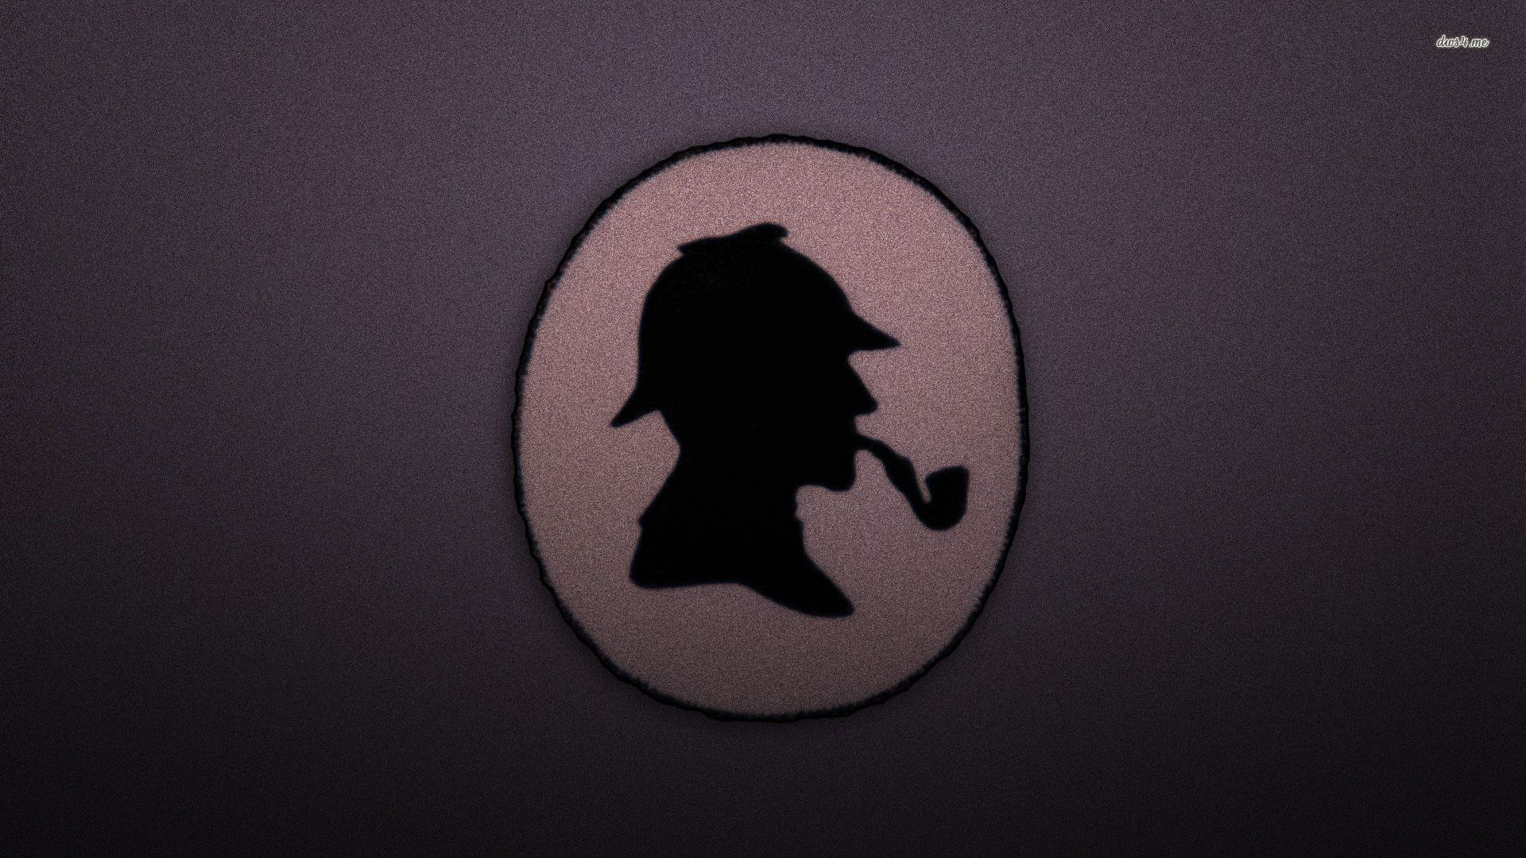
UNDER INVESTIGATION…

Slide 2
Sherlock Holmes?
Fictional character created by the Scottish writer Arthur Conan Doyle in 1887.
Arthur Ignatius Conan Doyle (1859-1930) was born in Edinburgh, Scotland. He worked as a surgeon on a whaling boat and also as a medical officer.
His first novel was published in Beeton’s Christmas Annual, under the title A Study in Scarlet which introduced us to the immortal Sherlock Holmes and Dr. Watson.

Slide 3
Golden Rule of Criminal Investigation?
The Golden Rule in Criminal Investigation. “ Do not touch, alter, move, or transfer any object at the crime scene unless it is properly marked, measured, sketched and/or photographed .”

Slide 4

Forensic Science?
Definition- The application of scientific technology to supply accurate and objective information reflecting the events that occurred at a crime
Or
The application of scientific knowledge to legal problems.

Slide 5
Before providing a short description of the forensic disciplines, it is necessary to discuss three concepts that are important in all forensic sciences.
Chain of Custody
The first involves maintaining the proper “chain of custody” when dealing with evidence.
Evidence of whatever type must be carefully and properly documented and evaluated.
Because of the nature of certain types of evidence it cannot all be collected and preserved indefinitely.
Maintaining a proper “chain of custody” involves producing and maintaining written documentation which accompanies the evidence and provides an uninterrupted timeline showing the secure location of the evidence from the time that it was discovered until the present time.

Slide 6
Any transfer of evidence from one person or secure location to another must be documented. Maintaining this chain of custody helps to ensure that the evidence has not been contaminated or compromised in any way.
If the proper “chain of custody” is not maintained, the breaking of the chain may well provide a potential reason for such evidence to be inadmissible in court.
Admissibility of Tests, Evidence and Testimony
The second issue of concern that crosses all fields of forensic science involves the existence of legal standards for the admissibility of forensic tests and expert testimony.
One legal standard for the admissibility of a forensic test is Frye v United States, which states that the forensic technique in question must have “general acceptance” by the scientific community

Slide 7
3. Expert Witness
The third issue that relates to all forensic science disciplines is the concept of the expert witness.
In contrast to a “fact witness,” who is usually only able to relate the facts of the issue at hand as he/she observed them, an “expert witness,” because of his/her specific expertise within a particular discipline, is also able to offer opinions regarding issues that relate to the specific discipline.
In order to be recognized as an expert witness, the witness must be officially qualified, or recognized as an expert, by the court.

Slide 8
What Is Crime?
Crime is defined as:
An act deemed as socially harmful or dangerous that is specifically defined, prohibited, and punished under criminal law.

Slide 9
CORPUS DELICTI “Body of the Crime”
You must prove:
that a crime occurred
that the person charged with the crime was responsible for the crime
Top Reasons for Committing a Crime
Money
Revenge
Sex
Emotion--love, hate, anger

Slide 10
MODUS OPERANDI “Mode of operating"
Modus operandi (MO) is a Latin term that means method of operating. It refers to the manner in which a crime has been committed. It is comprised of acts and decisions that are necessary to commit a crime, and any related choices made by an offender

Slide 11
The application of Forensic Science at the crime scene
The application of Forensic Science in the investigation of crime can be effective only if the investigating officer (IO) knows:
What are the evidences found
Where they could/would be found.
How it is collected and packed.
What type of standard samples for comparison purposes are necessary.
How much sample is required.
How the sampling is done.
How the packaging is done.
How the evidence will link with the crime and with the criminal.

Slide 12
History & development of Forensic Science
Mathieu Orfila (1787-1853), Spanish born but did work in France
Father of Forensic Toxicology
1814 published a Treatise on the detection of poisons.
James March (1836)- he was the first one to develop a test for the identification of Arsenic Poisoning
Alphonse Bertillon (1853-1914), French Scientist
1879 devised the first system of person’s ID using a series of body measurements
Devised the first crime scene kit – still used today.
The Bertillon system relied on a detailed description and measurement of the subject – Anthropometry (head length, head breadth, length of the middle finger, length of the left foot, and length of the cubit)
Francis Galton (1822-1911), British Scientist
1892 published the book “Finger Prints” which contained the 1st statistical proof supporting the uniqueness of fingerprints.
Laid the foundation of modern fingerprints.

Slide 13
Karl Landsteiner (1868-1943), Austrian, immigrated to the U.S.
1901 Discovered human blood could be grouped into different categories (A, B, AB, and O).
1930 Won Nobel Prize.
1940 helped to discover the Rh factor in human blood.
Leone Lattes (1887-1954), Italian Scientist
1915 devised a procedure by which dried bloodstains could be grouped as A, B, AB, or O (by using the diluted isotonic solution of NaCl)
His procedure is still used today by some forensic scientists
Calvin Goddard (1891-1955), U.S. Army colonel
Developed the Comparison Microscope
Refined the techniques of determining if a gun had fired a specific bullet. (Ballistics)

Slide 14
Albert S. Osborn (1858-1946), American Scientist.
1910 published the book “Questioned Documents.”
The book became a primary reference for document examiners.
Hans Gross (1847-1915), Lawyer and Judge in Austria
1893 Published the first treatise on applying science to criminal investigation
Started the forensic journal “Kriminologie”
Edmond Locard (1877-1966), 1910 set up the first Forensic Lab in Lyons, France
Founder and Director of the Institute of Criminalistics @ the University of Lyons
Formulated the Locard’s Exchange Principle

Slide 15
Reference of investigative methods are found in Kautilya’s “Arthashastra” about 2300yrs old.
Indians studied patterns of papillary lines, thousands of years back.
Chemical Examiner’s Lab: Set up first at the Madras Presidency, Dept. of Health, 1849 followed by Calcutta (1853), Agra (1864) & Bombay (1870).
Anthropometric Bureau: established in 1892 at Calcutta.
5. Finger Print Bureau: The first one in the world at Calcutta, July 1897.
Willian Herschel, Collector of District of Hooghly, found that the FPs never changed in lifetime. He applied this knowledge in registration of thumb/finger impressions of the natives. This registration was then extended to convicted criminals in prisons as well. However, his ideas were not given a consent.
In 1891, Edward Richard Henry, IGP, Bengal, introduced the thumb impressions in the record slips containing Anthropometric data.
Khan Bahadur Azizul Haq and Rai Bahadur Hem Chandra Bose worked under him. It was Azizul Haq who evolved a mathematical formula to supplement Henry’s idea of sorting slips in 1024 pigeon holes, based on fingerprints. Hem Chandra Bose developed an extended system of sub-classification.

Slide 16
6. Department of Explosives: The foundation for the Dept was laid when the first Inspector of Explosives was appointed in 1898 with its HQs at Nagpur and 5 regional offices at Calcutta, Bombay, Agra, Madras & Gwalior and three sub-offices at Shivkashi, Gomia, & Asansol.
7. Govt Examiner of Questioned Document: The British Govt of Bengal created the post of govt handwriting expert of Bengal. Mr C.R. Hardless, the then superintendent in the A.G’s office in Bengal was appointed for this post in 1904. this was shifted to Shimla in 1906, under the control of Director, CID. Mr. C.R. Hardless was appointed as the Handwriting Expert for Govt of India. Later he was replaced by Mr. F.Brewester, a police officer from WB CID and was designated as Govt examiner of Questioned Documents (GEQD).
8. Serologist to the Govt of India: Serology Department was established in Calcutta in 1910. The HoI was designated as the Imperial Serologist to the Govt of India.
9. Footprint Section of Criminal Investigation Dept: In 1915, a Footprint Section was established under the CID, Govt of Bengal.
10. Note Forgery Section in Criminal Investigation Dept.: In 1917, a Note Forgery Section was set up under the CID, Govt of Bengal for examination of forged currency notes.
The Revenue Dept was set up for identification of opium, narcotics, precious metals, etc.
Govt Mint and Security Printing Dept at Nasik was set up for detecting Counterfeit and forged currency.
11. Ballistics Laboratory: In 1930, an Arms Expert was appointed and a Ballistics laboratory was set up a under the Calcutta Police.

Slide 17
Evolution of FSL’s
3 types of FSLs:
CFSLs
SFSLs
RFSLs
First FSL---Calcutta (1952)
Medico-legal section of Chemical Examiner’s Laboratory, physics Section, Foot print and note forgery sections od CID was transferred here, Chemistry Section of CEL was also transferred here
Second FSL---Bombay (1958)
It has 5 regional labs at Nagpur, Aurangabad, Pune , Nasik, & Amravati

Slide 18
CFSL and other Central Institutes
Central Finger Print Bureau: Established in 1905 in Shimla but abolished in 1922. The CFPB restarted from 1955 in Delhi under the purview of IB. In August 1956, it was shifted to Calcutta. In Sept 1973 it was transferred to the CBI from IB. In July 1986, it came under the purview of NCRB and was shifted to ND.
2. Central Detective training School at Calcutta:
Was established in 1956 in Calcutta.
3. CFSLs: First CFSL- Calcutta(1957)
Second CFSL-Hyderabad (1965)

Slide 19
Forensic science: Functions
Forensic science provides answer to the following three questions:
Has a crime been committed?
Consider the case of recovery of a dead body. Death could be natural, accidental or homicidal. By ascertaining the nature of death, it can be establish the existence or absence of corpus delicti.
2. How and when was the crime committed?
The examination of the corpus delicti reveals the way of the crime was committed and possibly the time when it was committed.
3. Who has committed the crime?
Forensic science establishes the identity of the culprit through personal clues like fingerprints, footprints, blood drops or hair. It links the criminal with the crime through the objects that have been left by him at the scene with the victim or which have been carried from the scene by the victim.

Slide 20
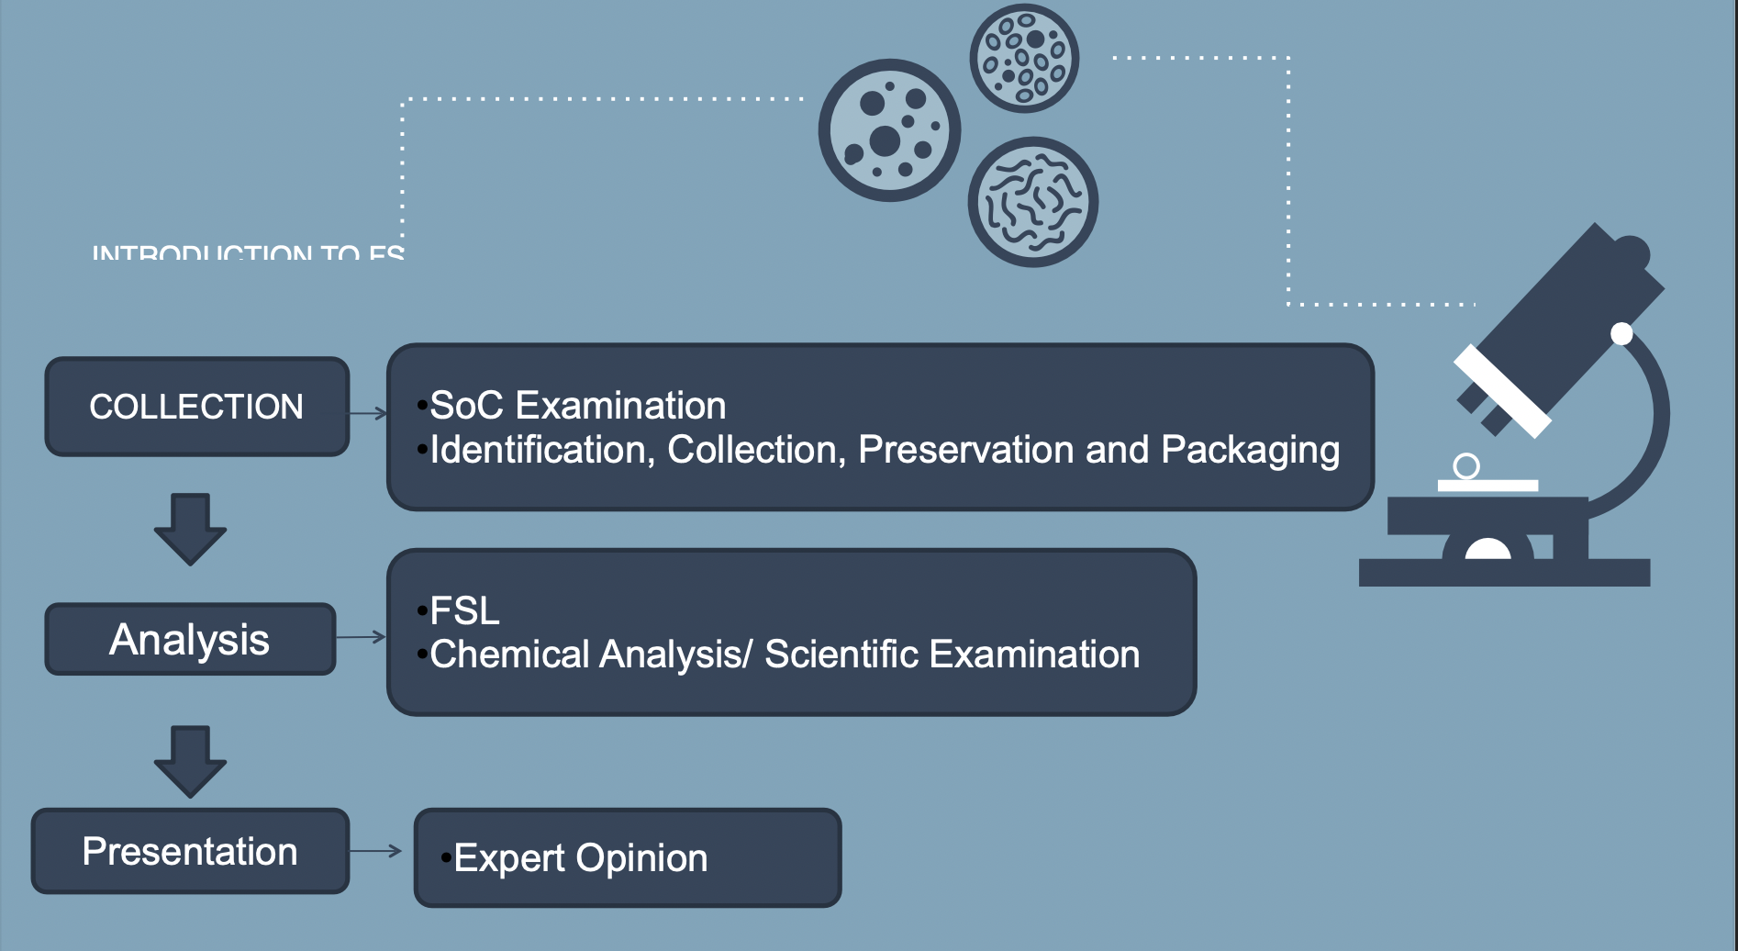
Forensic Sciences

Slide 21
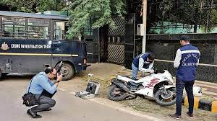
Divisions of Forensic Science Laboratory
An ideal Forensic Science Laboratories is generally divided into the following divisions:\
Photography (Common for all the divisions)
Identification of camera from film negatives
Identification of Source camera
Preparation of photographs
Crime Scene Photography
Post Mortem Photography/Videography

Slide 22
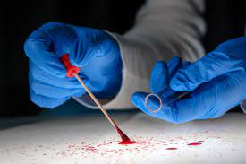
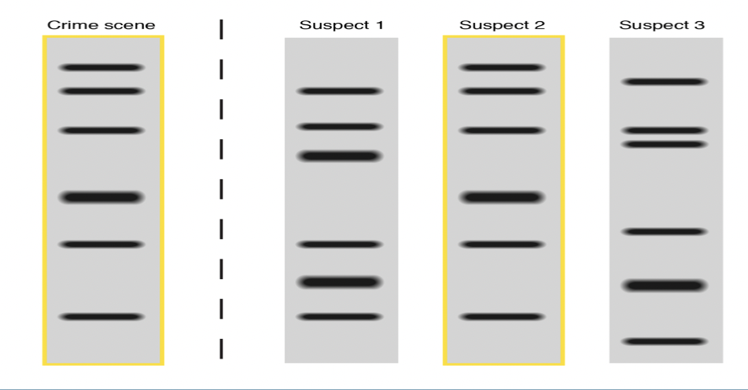
Divisions of Forensic Science Laboratory
2. Biological sciences, which include, Biology unit /Serology unit / DNA unit
The Forensic Biology/DNA Unit uses high-quality technology and scientific processes to detect, collect, and interpret the results from biological evidence.

Slide 23
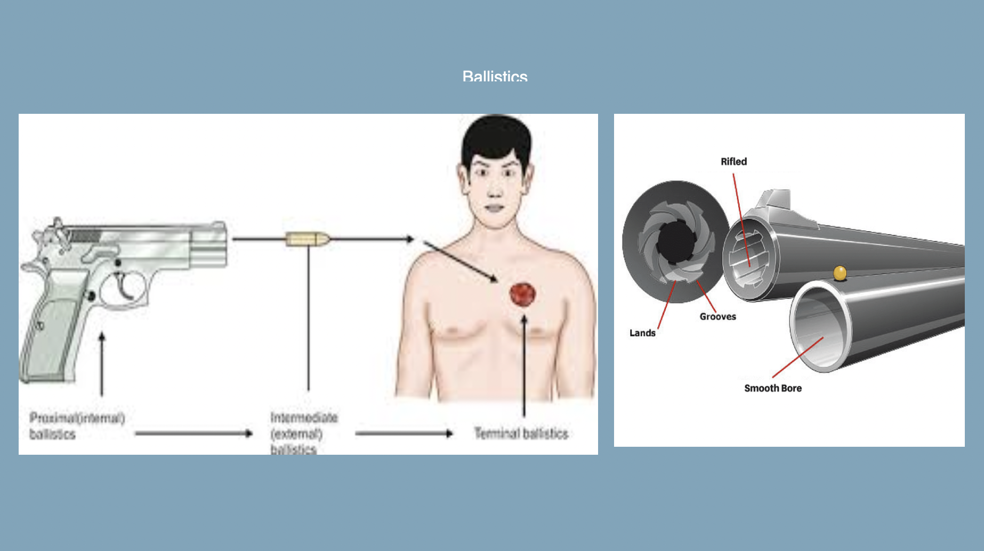
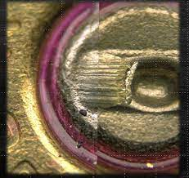
3. Ballistics Division
Ballistics division undertakes following examinations: Examination for serviceability/working condition of firearm (pistol & revolver). Examination for serviceability of ammunition (handgun / rifle). Determination of type, make and calibre of unfired cartridge/fired cartridge case
Divisions of Forensic Science Laboratory

Slide 24
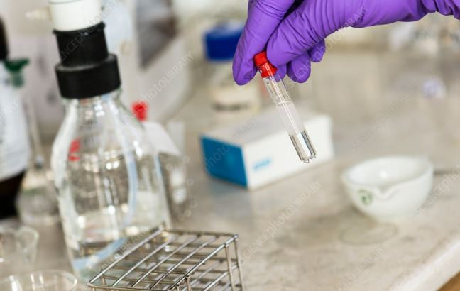
Divisions of Forensic Science Laboratory
4. Chemical Sciences Division
Undertakes examination of exhibits like:
Explosive Residues, Acid, Precious Stones,
Metal, Liquor etc. ND&PS substances like
Heroin, Ganja, Brown sugar, Opium etc.
Chemistry unit
Toxicology unit
Narcotics unit
Explosive unit

Slide 25
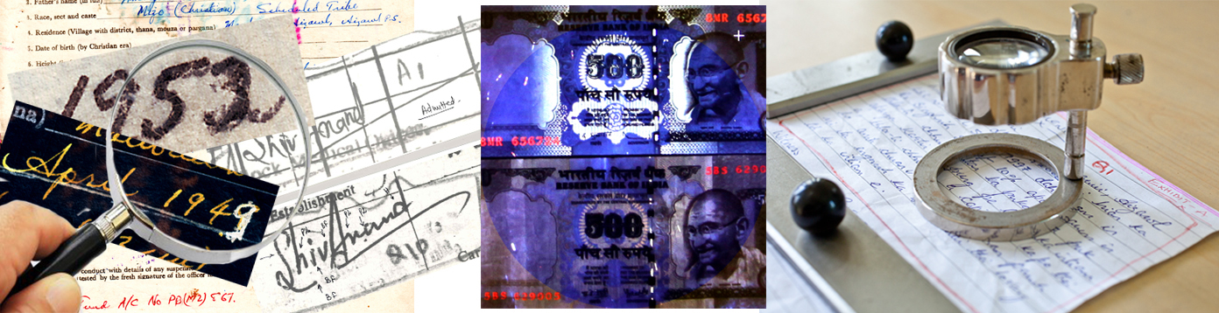
5. Documents Division:
Handwriting & Signatures – To examine/compare with standard (admitted & specimen) writings.
Latent Writing on Documents – To detect and decipher.
Fake Indian Currency Notes of Different Denomination – To examine presence of security/essential features prescribed by RBI.
Printed matter – To examine/compare with standard ones.
Stamp Impression – To examine/compare with the standard stamped impression.
Erasing, Alteration, Overwriting etc. – To detect and decipher such features on questioned documents.
Fake documents, stamps, stamp papers, security papers – To ascertain genuineness.
Divisions of Forensic Science Laboratory

Slide 26
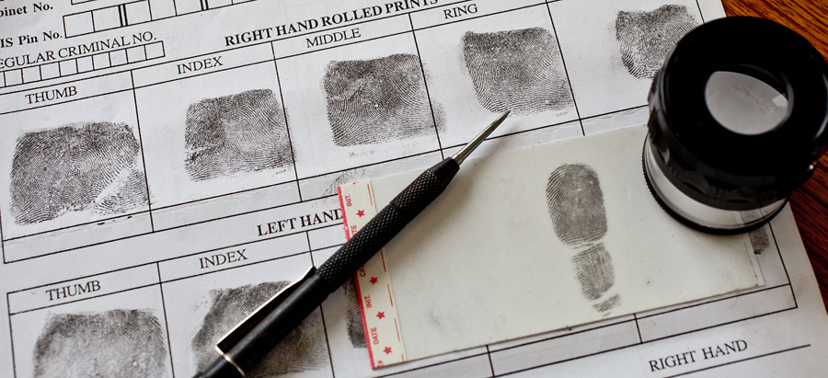
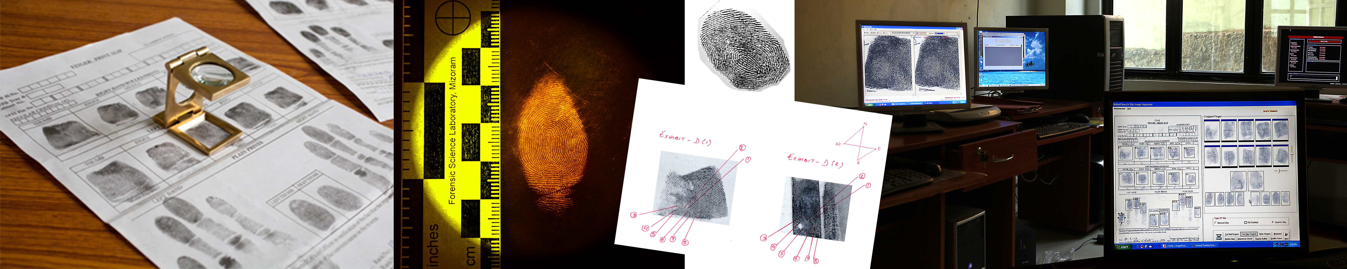
Divisions of Forensic Science Laboratory
6. Fingerprint Division
Maintaining fingerprint record slips.
Conducting Fingerprint search
Undertaking examination of Questioned Fingerprint impression on documents
Examining and comparing the chance prints
Developing latent prints
Examining unidentified dead body in establishing identity with available fingerprints on record.

Slide 27

Divisions of Forensic Science Laboratory
7. Cyber Division: Deals with-
a. Disk Forensics
Extraction and analysis of data from Computer hard disks, USB devices, floppy, CD, DVD, and Flash drives.
b. Mobile Device Forensics
Extraction and analysis of data from handheld devices like mobile phones, Smartphones, tablets, etc.
c. Memory Forensics
Analysis of volatile data in a computer's memory dump.
d. Network Forensics
Monitoring and analysis of computer network traffic.
e. Multimedia Forensics
Analysis of multimedia signals (audio, videos, images
f. Internet Forensics
Tracking and analysis of e-mails, social media, websites, and cloud storage.
g. Cryptocurrency Forensics
Tracking of cryptocurrency transactions through thousands of social media forums and Darknet sites.
Forensic Field Kit

Slide 28
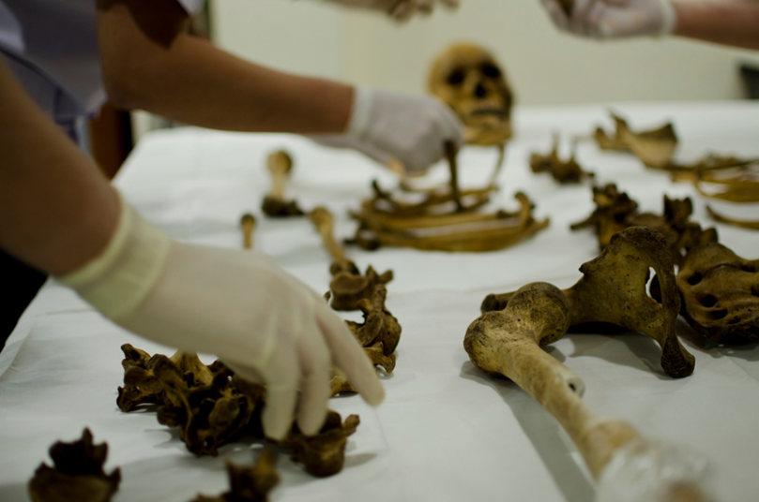
Divisions of Forensic Science Laboratory
8. Medico-legal Division:
Forensic Medicine (Postmortem and antemortem Investigation, Victim and criminal’s body assessment, etc.)
Forensic Toxicology (Poisons and their effects)
Forensic Pathology (Tissue study- Mostly post-mortem)
Mass Disaster Management

Slide 29
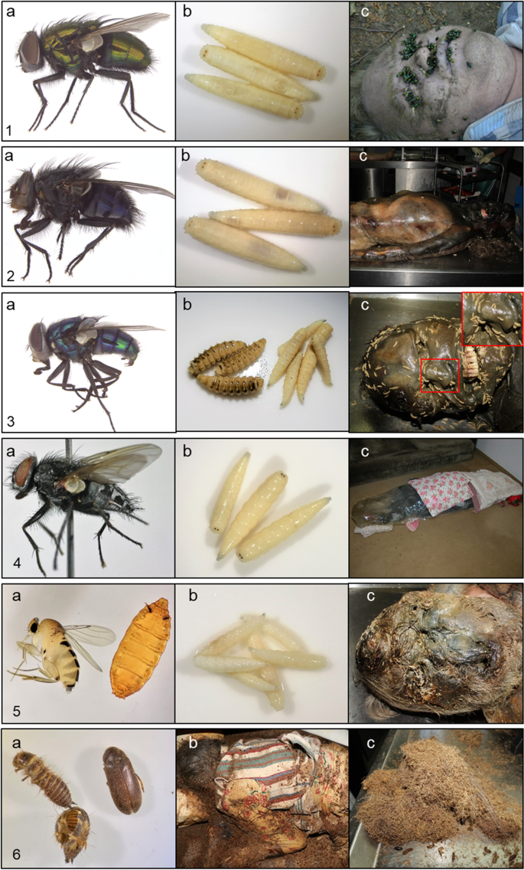
Divisions of Forensic Science Laboratory
9. Entomology Division
The study of the application of insects and other arthropods in the criminal investigation. Insects or arthropods are found in a decomposing vertebrate corpse or carrion.

Slide 30
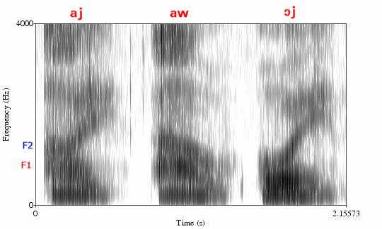
Divisions of Forensic Science Laboratory
10. Audio Forensics
Audio forensics is the field of forensic science relating to the acquisition, analysis, and evaluation of sound recordings that may ultimately be presented as admissible evidence in a court of law or some other official venue.
Sound spectrograph developed using the instrument, Audio Spectrogram, between the control and test samples

Slide 31
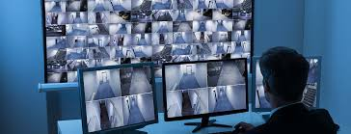
Divisions of Forensic Science Laboratory
11. Video Forensics
Forensic video analysis is the scientific examination, comparison, and/or evaluation of video in legal matters.
The video forensic process must be performed in a forensic lab that is equipped with the appropriate tools and follows best practice protocols in order to process the video recording with integrity and accuracy.

Slide 32
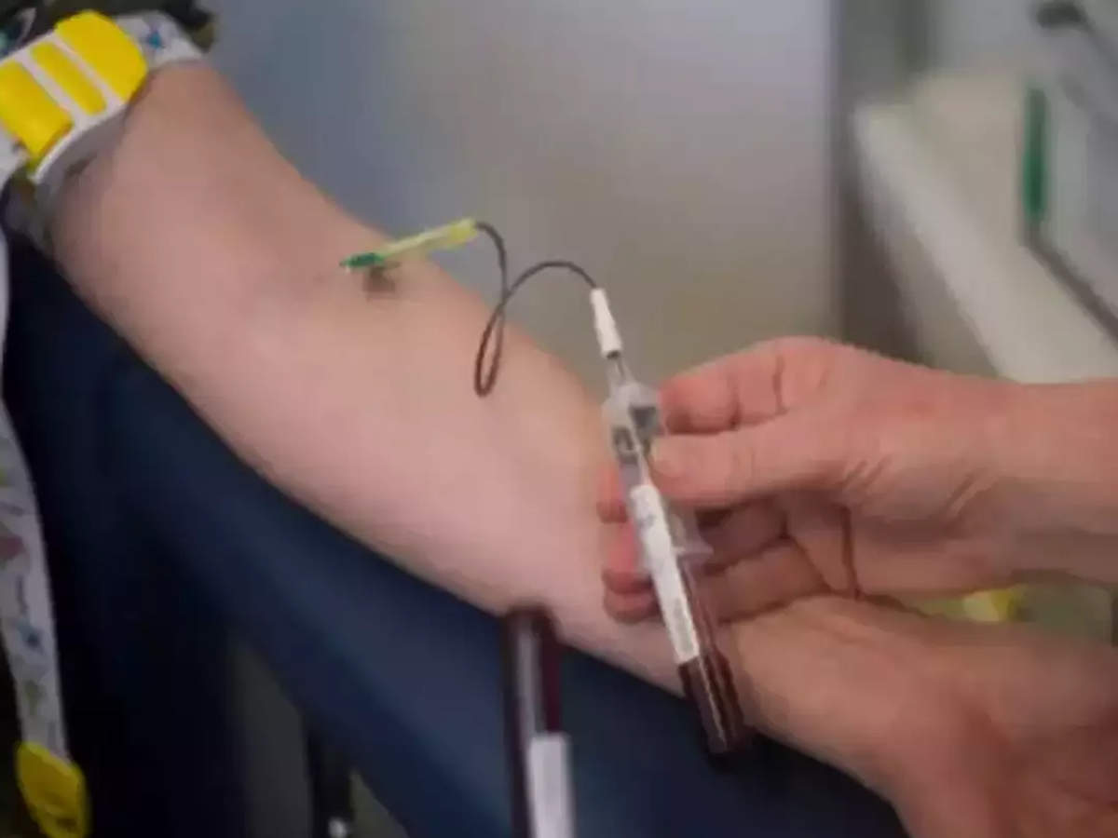
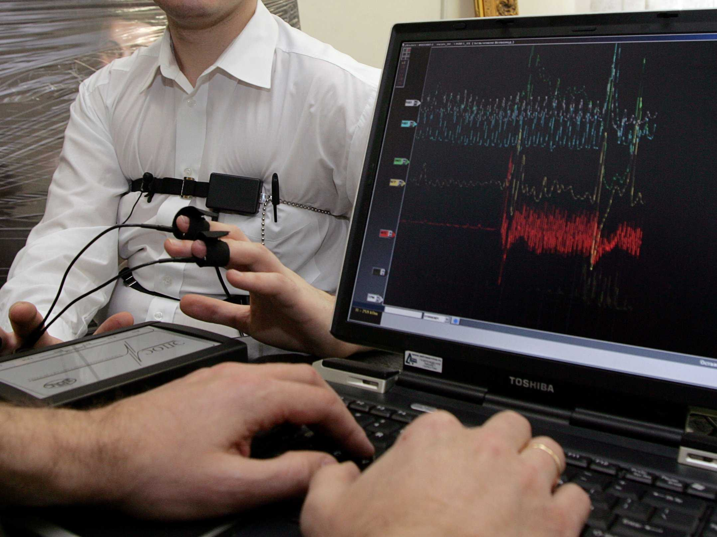
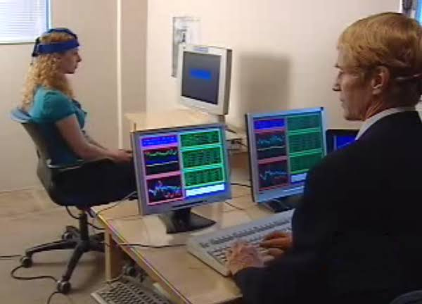
Divisions of Forensic Science Laboratory
11. Psychology Division
Psycho-physiological detection of deception (PDD) (Lie detection)
Narco-analysis
Brain Fingerprinting
Criminal Profiling

Slide 33
Divisions of Forensic Science Laboratory
Psycho-physiological detection of deception (PDD) (Lie detection) - Originating from the Polygraph, lie detection based on sophisticated measures of Bio-feedback and continuous recording of minor variations on complex computer programs, provides a whole range of instruments. The basic principle is to provide psychologically arousing cues intermittently while monitoring the changes using pulse, temperature, respiration, skin conductivity, or any other physiological measure. In this process an individual trying to mislead by providing untrue information can be identified.
Narco-analysis- In this analysis, the subject's imagination is neutralized by making him semi-conscious. In this state, the person cannot lie to any question. Experts inject the subject with intravenous hypnotic medications like Sodium Pentothal or Sodium Amytal. The dose is dependent on the person's sex, age, health, and physical condition. This process too cannot be conclusive without the active role of a forensic psychologist.

Slide 34
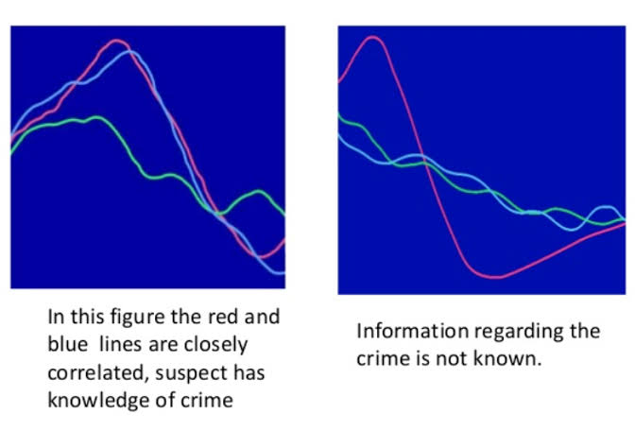
Divisions of Forensic Science Laboratory
Brain Fingerprinting - Brain fingerprinting is a forensic science technique that uses electroencephalography (EEG) to determine whether specific information is stored in a subject's brain by measuring electrical brainwave responses to words, phrases, or pictures that are presented on a computer screen.

Slide 35
Divisions of Forensic Science Laboratory
Criminal profiling- It is profiling the offender based on clinical/psychological analysis of the consistent behavioural and personality features. After in depth accurate understanding of the psycho-social functioning, a profile is created which assists in predicting the characteristics of unknown criminal subjects or offenders, thus, leading to apprehending them..
Aim of Criminal Profiling:
To help the investigators in identifying an unknown criminal from the profile.
To indicate psychological portrait of the subject (criminal).
To understand the criminal’s pattern, type of evidence they can expect from the SOC and type of interrogation method they can use in the investigation process.

Slide 36
Field Units or Mobile Laboratory- Helps in reaching the crime scene at the earliest as to aid the investigation officers in proper preservation, collection, packaging, transportation of all the relevant evidences present at the scene of crime

Slide 37
Short summary of the Chapter
Forensic science is the application of science to criminal and civil laws that are enforced by police agencies in a criminal justice system
The first system of personal identification was called anthropometry. It distinguished one individual from another based on a series of bodily measurements.
Locard’s exchange principle states that, when two objects come into contact with each other, a cross-transfer of materials occurs that can connect a criminal suspect to his or her victim
A forensic scientist must be skilled in applying the principles and techniques of the physical and natural sciences to analyzing evidence that may be recovered during a criminal investigation.
The cases Frye v. United States and Daubert v. Merrell Dow Pharmaceuticals, Inc. set guidelines for determining the admissibility of scientific evidence into the courtroom.
Forensic scientists participate in training law enforcement personnel in the proper recognition, collection, and preservation of physical evidence.

